Slide 1
Function calling
Give models access to new functionality and data they can use to follow instructions and respond to prompts.
Function calling (also known as tool calling) provides a powerful and flexible way for OpenAI models to interface with external systems and access data outside their training data.
Tool calling (or function calling) enables LLMs to interact with external systems, APIs, and databases, allowing AI to perform actions rather than just generating text
The model intelligently analyzes user queries, determines if a tool (defined via JSON schema) is necessary, and outputs structured arguments for execution.

Slide 2
Key Aspects of Tool Calling:
Workflow:
The user prompts the model, the model outputs a tool call request, the application executes the tool, and sends the results back to the model to generate the final response.
Capabilities:
It expands LLM functionality to include fetching real-time data, performing complex calculations, and automating tasks like sending emails or updating databases.
Types of Actions:
Common use cases include information retrieval (search, databases), code execution (Python/Math engines), and process automation (CRMs, IoT).
Implementation:
Tools are defined in the context, often using JSON Schema to specify name, description, and required parameters.
Frameworks:
Tools like LangChain, LangGraph, and Spring AI are commonly used to manage these interactions.
This technology is crucial for building autonomous AI agents that require up-to-date, specialized knowledge beyond their training data.

Slide 3
How it works
Let’s begin by understanding a few key terms about tool calling.
Tools - functionality we give the model
Tool calls - requests from the model to use tools
Tool call outputs - output we generate for the model
Functions versus tools

Slide 4
1. Tools - functionality we give the model
A function or tool refers in the abstract to a piece of functionality that we tell the model it has access to.
As a model generates a response to a prompt, it may decide that it needs data or functionality provided by a tool to follow the prompt’s instructions.
You could give the model access to tools that:
Get today’s weather for a location
Access account details for a given user ID
Issue refunds for a lost order

Slide 5
Cont’d
Or anything else you’d like the model to be able to know or do as it responds to a prompt.
When we make an API request to the model with a prompt, we can include a list of tools the model could consider using.
For example, if we wanted the model to be able to answer questions about the current weather somewhere in the world, we might give it access to a get_weather tool that takes location as an argument.

Slide 6
2. Tool calls - requests from the model to use tools
A function call or tool call refers to a special kind of response we can get from the model if it examines a prompt, and then determines that in order to follow the instructions in the prompt, it needs to call one of the tools we made available to it.
If the model receives a prompt like “what is the weather in Paris?”
in an API request, it could respond to that prompt with a tool call for the get_weather tool, with Paris as the location argument.

Slide 7
3. Tool call outputs - output we generate for the model
A function call output or tool call output refers to the response a tool generates using the input from a model’s tool call.
The tool call output can either be structured JSON or plain text, and it should contain a reference to a specific model tool call (referenced by call_id in the examples to come).
To complete our weather example:
The model has access to a get_weather tool that takes location as an argument.
In response to a prompt like “what’s the weather in Paris?” the model returns a tool call that contains a location argument with a value of Paris
The tool call output might return a JSON object (e.g., {"temperature": "25", "unit": "C"}, indicating a current temperature of 25 degrees).
We then send all of the tool definition, the original prompt, the model’s tool call, and the tool call output back to the model to finally receive a text response like:
The weather in Paris today is 25C.

Slide 8
Functions versus tools
A function is a specific kind of tool, defined by a JSON schema.
A function definition allows the model to pass data to your application, where your code can access data or take actions suggested by the model.
In addition to function tools, there are custom tools that work with free text inputs and outputs.
There are also built-in tools that are part of the OpenAI platform.
These tools enable the model to search the web, execute code, access the functionality of an MCP server, and more.

Slide 9
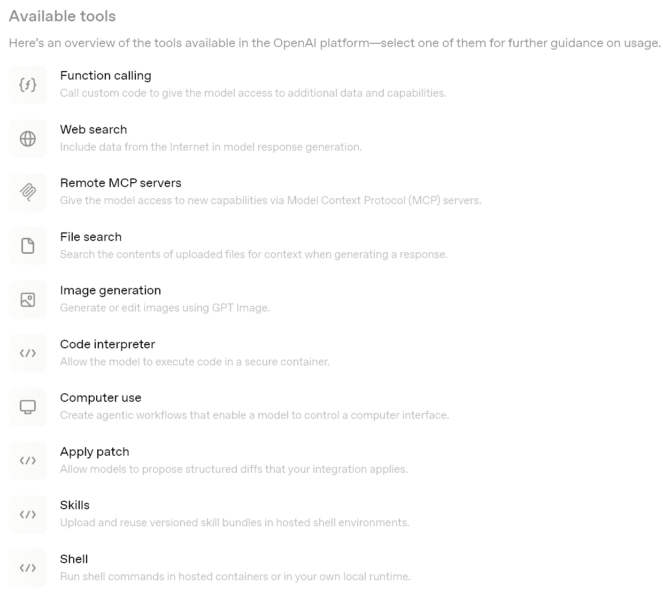

Slide 10
The tool calling flow
Tool calling is a multi-step conversation between your application and a model via the OpenAI API.
The tool calling flow has five high level steps:
Make a request to the model with tools it could call
Receive a tool call from the model
Execute code on the application side with input from the tool call
Make a second request to the model with the tool output
Receive a final response from the model (or more tool calls)

Slide 11
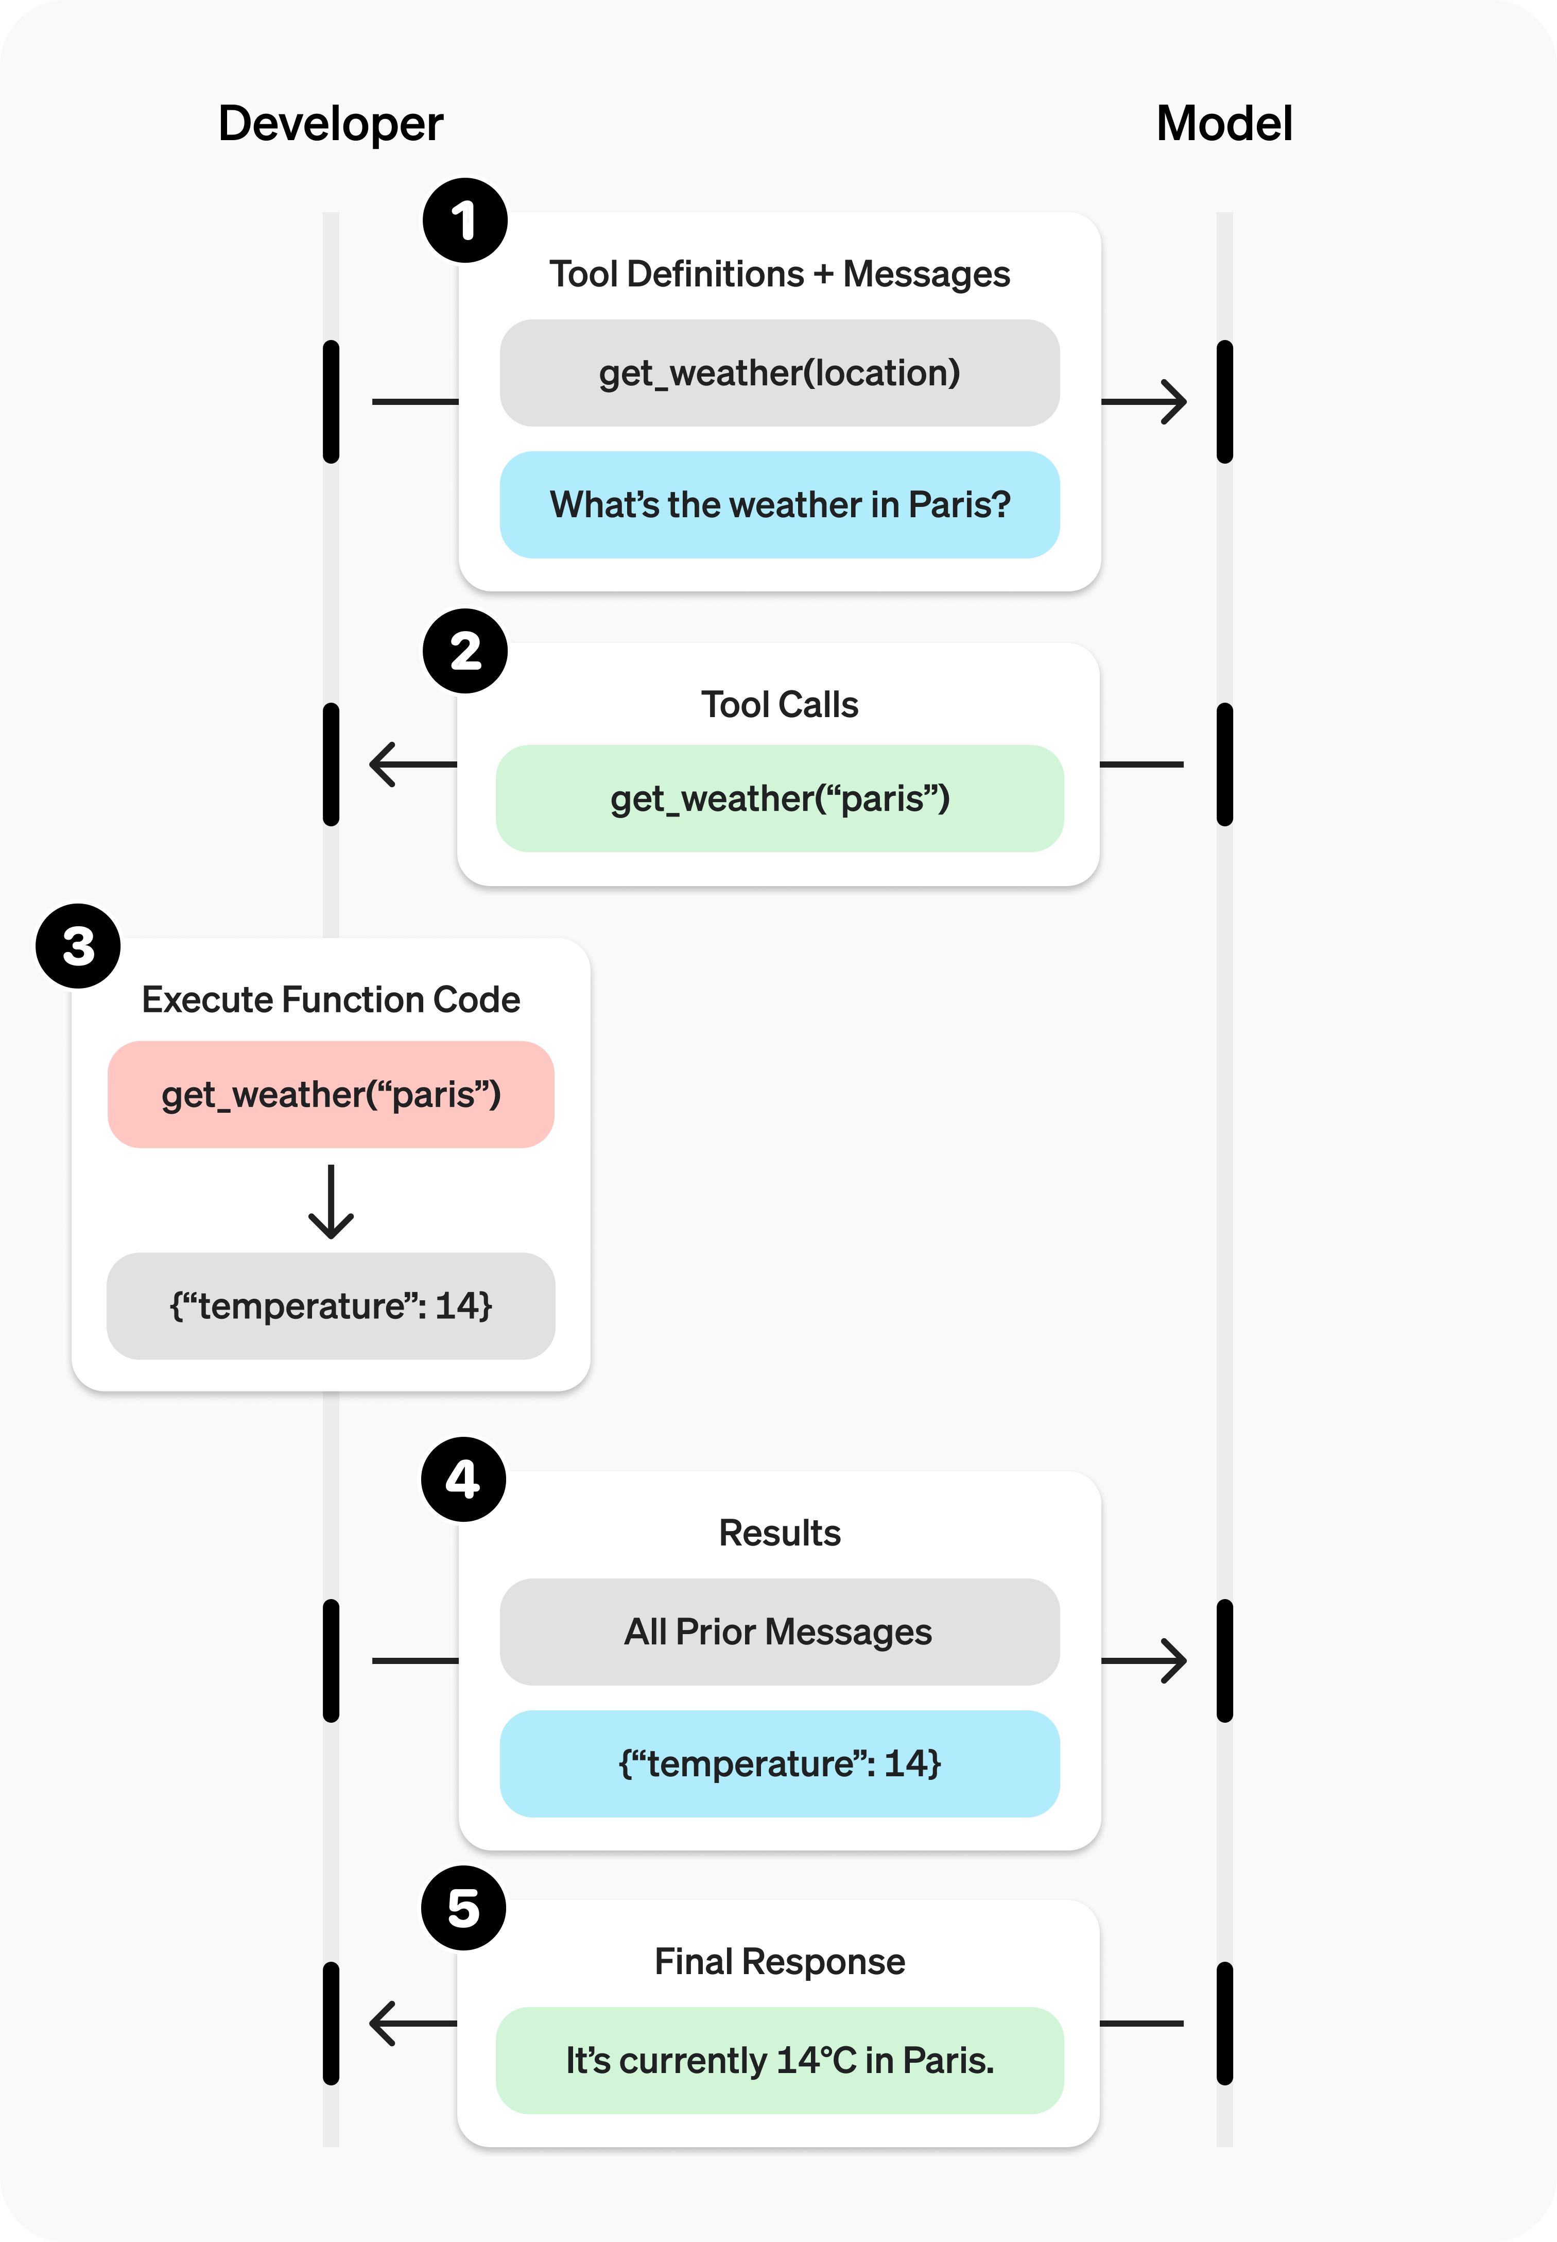

Slide 12
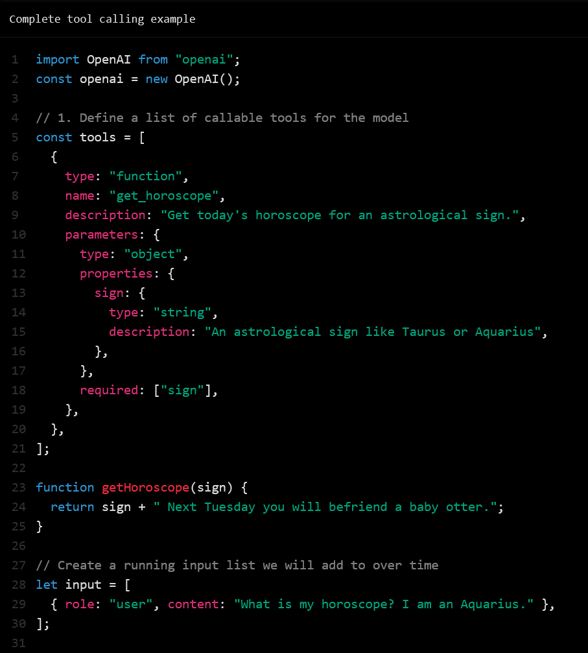

Slide 13
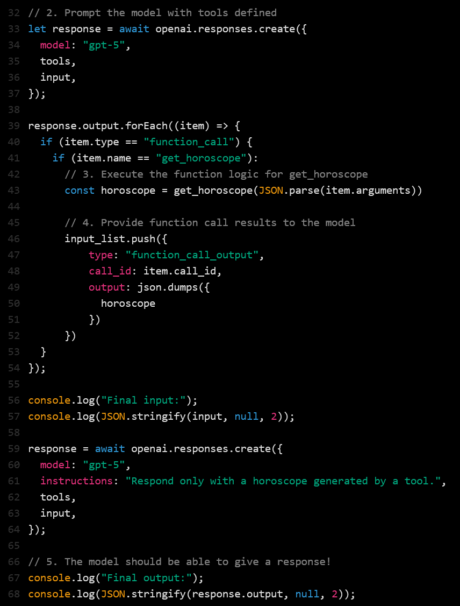

Slide 14
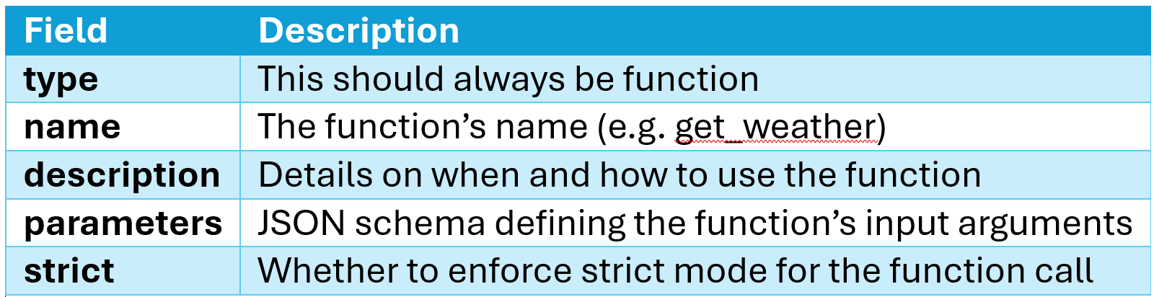
Defining functions
Functions can be set in the tools parameter of each API request.
A function is defined by its schema, which informs the model what it does and what input arguments it expects.
A function definition has the following properties:

Slide 15
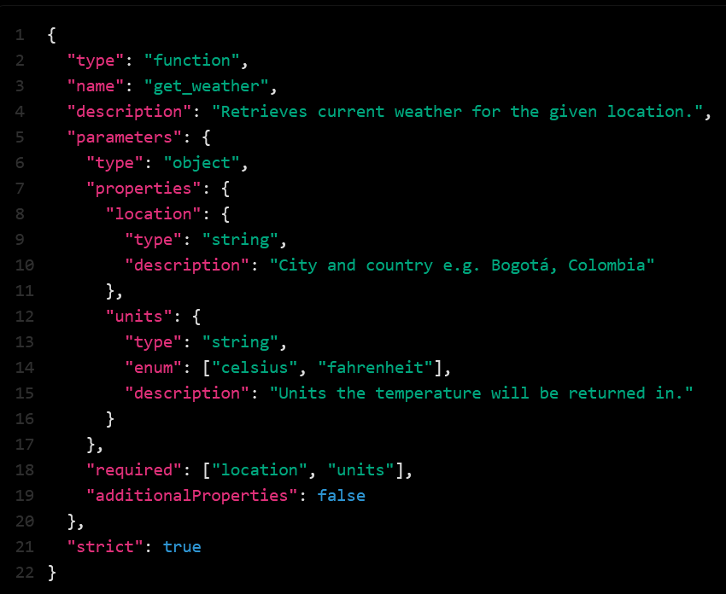
Here is an example function definition for a get_weather function

Slide 16
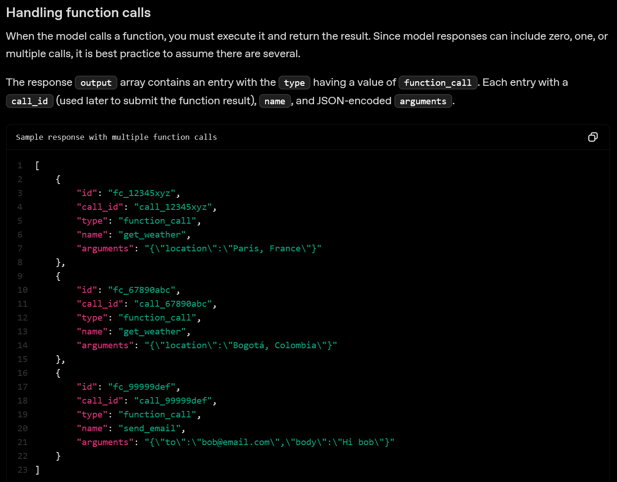

Slide 17
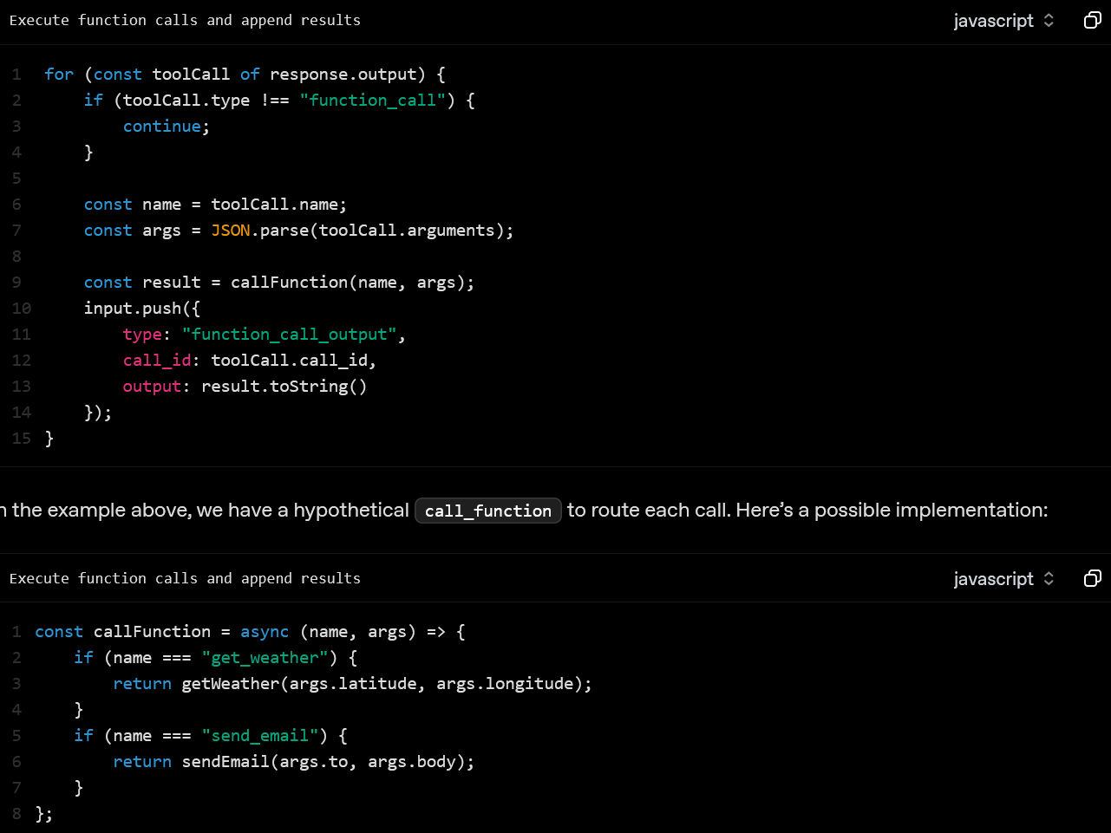

Slide 18
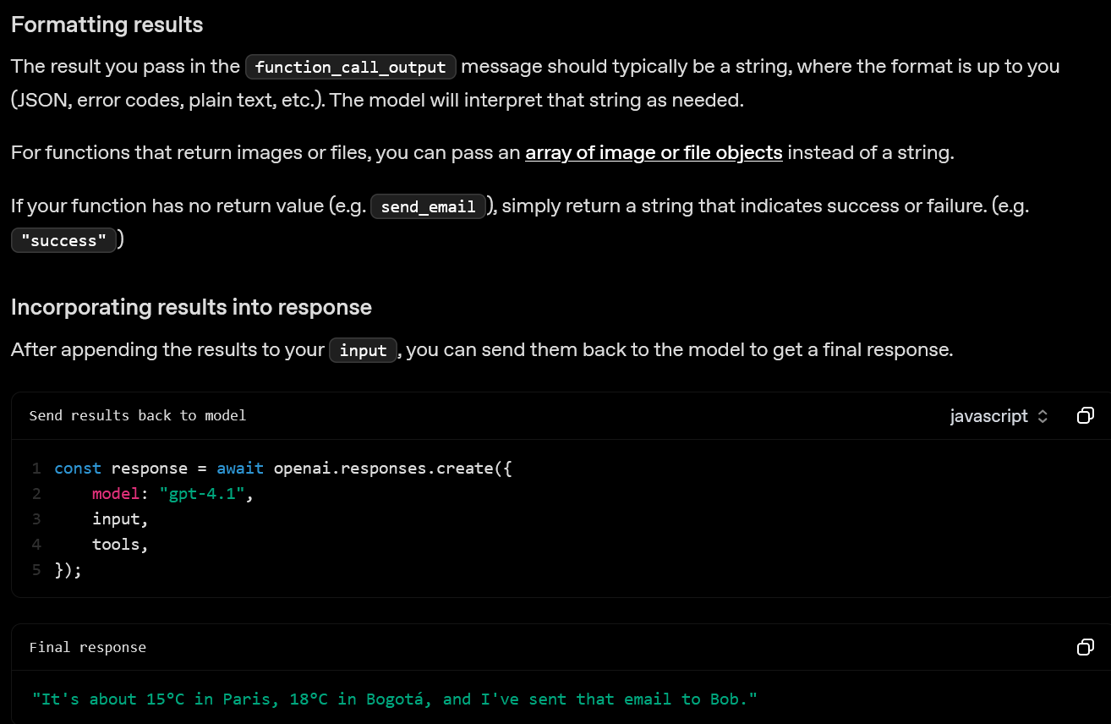

Slide 19
